Slide 1
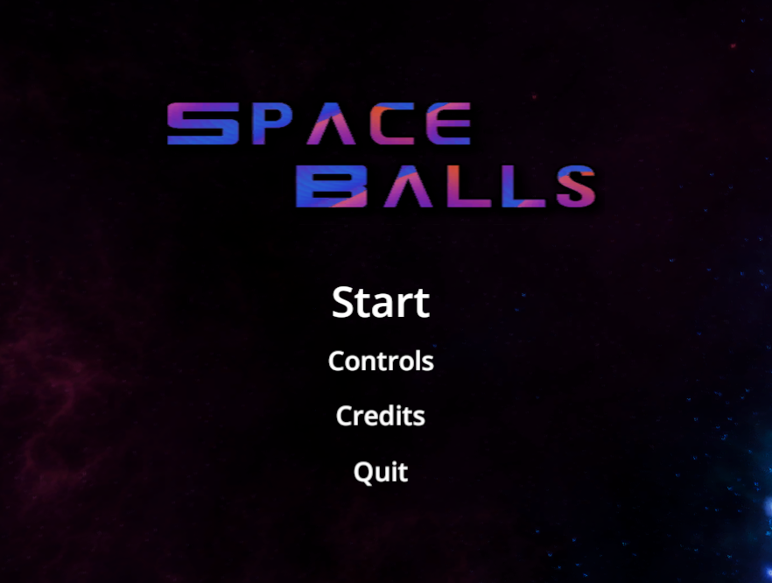
Final Project - SpaceBalls
By Team 6: Ajai Gorowara, Christopher Reece, Travis Qing, Tyler Washington & Joshua Day

Slide 2
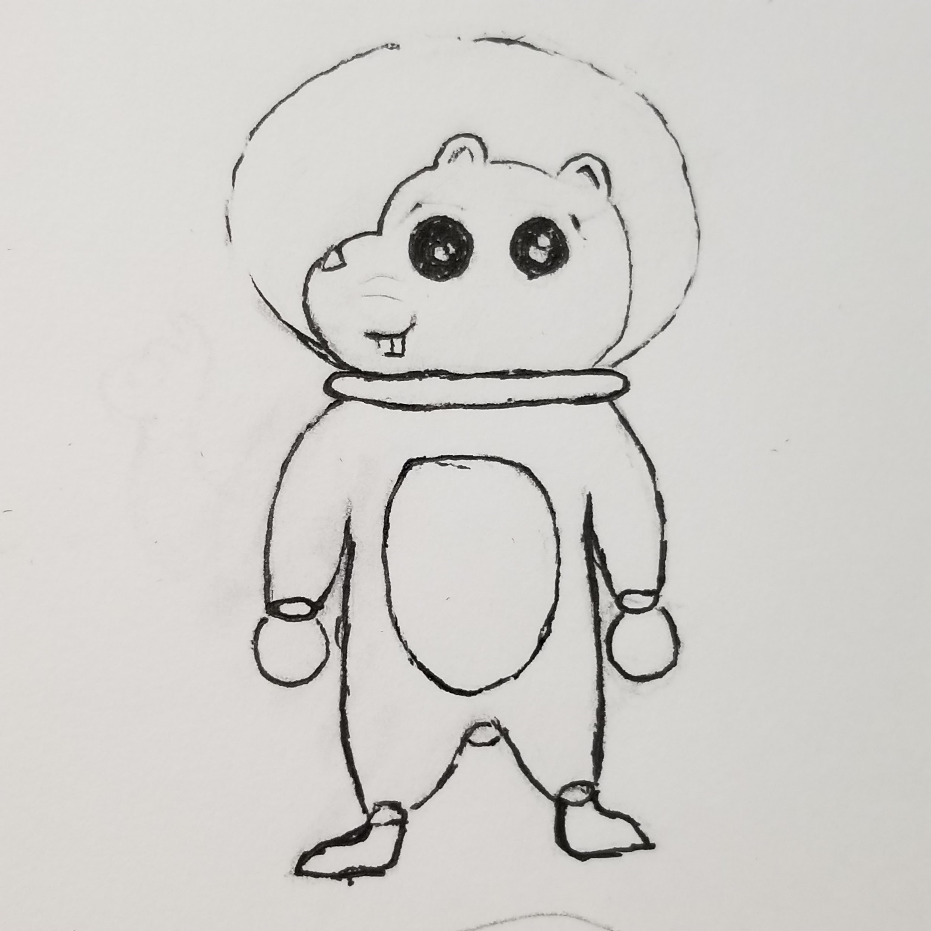
What is SpaceBalls
Spaceballs is a physics-based game allowing you to be the best hamster captain in space by gathering crystals faster than your Cricetinae competitors. Rather than chasing after crystals, you move the world to bring the crystals to you and then make it to the goal.

Slide 3
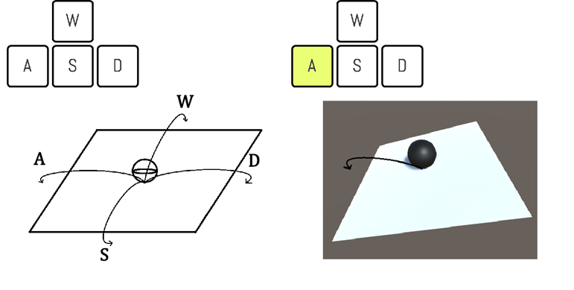
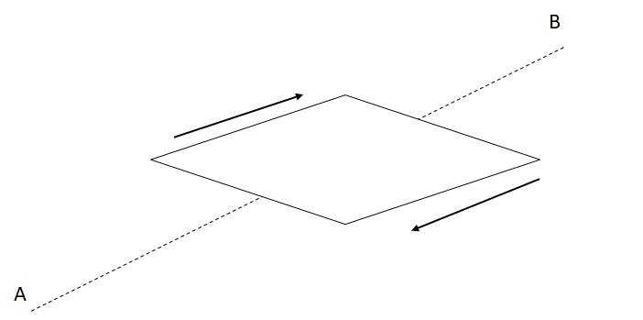
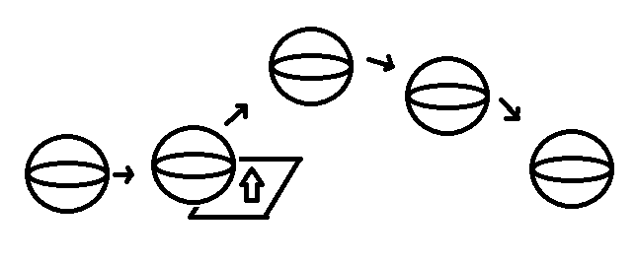
Analysis of Game Mechanics
Tilt Controls
The player uses the WASD keys to tilt the stage relative to both the player’s location and the direction of the camera. The W, A, S, and D keys tilt the platform forwards, backwards, to the left, and to the right respectively.
Moving Platforms
Platforms that move back and forth between two set points. The player can move along these platforms without any input
Bounce Platforms
Platforms that send the player upwards at a set height. The player can affect the direction that the go in with the tilt controls.

Slide 4

What Went Right
We had a solid design document, this meant we did not have much trouble knowing what needed to be done for the game
We had most of our core mechanics functioning quite early. This allowed for us to focus on building good levels.

Slide 5
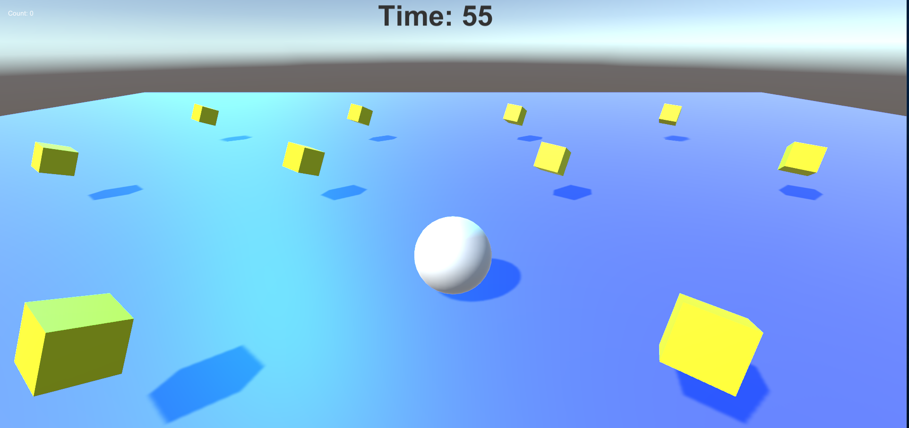
What Went Wrong
Due to the limitations of Unity, we could not fully implement the tilt stage mechanic. This was because we could not find a usable way to set a max rotation for the tilting.
We were constantly behind schedule, but mainly with art. We were not able to implement textures and models until a day or two before the turn in date.
Constant problems with computers and other outside variables made it harder to complete work.
Issues with team members not knowing what work needs to be completed

Slide 6

What Changes were made
The leaderboard could not be implemented, so we had to make changes to the points system.
We did not implement the mouse camera control due to issues with the tilt control
Points system had to be simplified due to time constraints

Slide 7

What we learned
Setting a concrete schedule would have helped with building the game, rather than having to do a large amount of work the day it is due
Researching the limitations of Unity before deciding on a concept
Making sure that everyone on the team is on the same page of what needs to be completed

Slide 8
Gameplay Video
https://youtu.be/ucLh8oaFm9M

Slide 9
Credits
Ajai Gorowara:
Team Leader, Level Designer and Programmer
Christopher Reece:
Main Programmer
Tyler Washington:
Art Designer
Travis Qing:
Programmer and Level Designer
Joshua Day:
Art Designer

